Slide 1
Multi-sensor rail track detection in automatic train operations
Master’s thesis in Data Science
Student: Attila Kovacs
1st Advisor: Lukas Rohatsch (UAS Technikum Wien)
2nd Advisor: Daniele Capriotti (M2C Expert Control GmbH)
26.06.2024

Slide 2
Motivation
Automatic train operations (ATO)
ATO systems use advanced technologies to interpret the railway environment to facilitate autonomous operations with minimal human intervention
Automatic rail track detection
Computer vision-based rail track detection is a crucial component that enables autonomous train navigation in complex rail networks

Slide 3
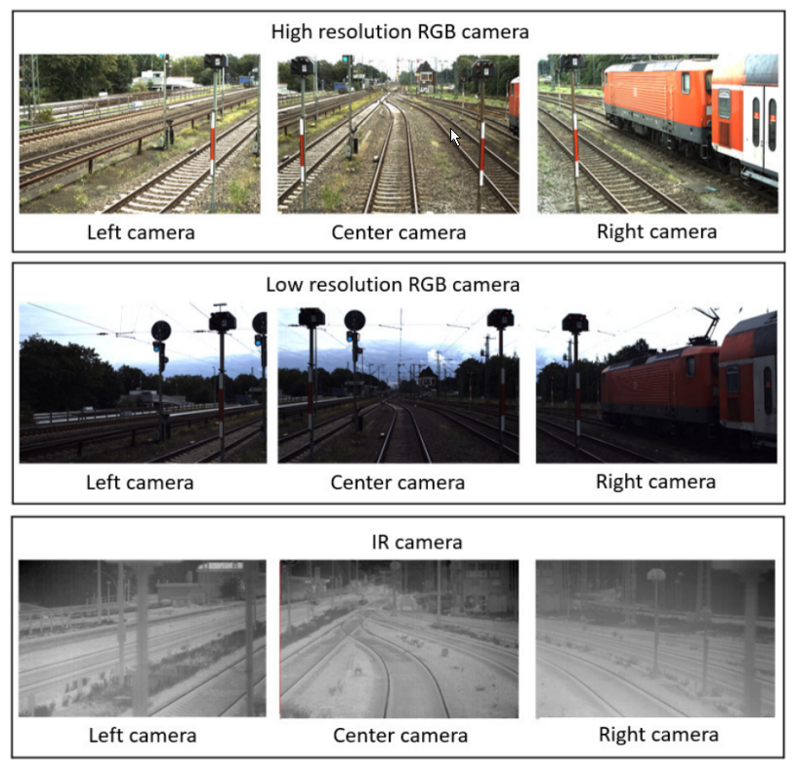
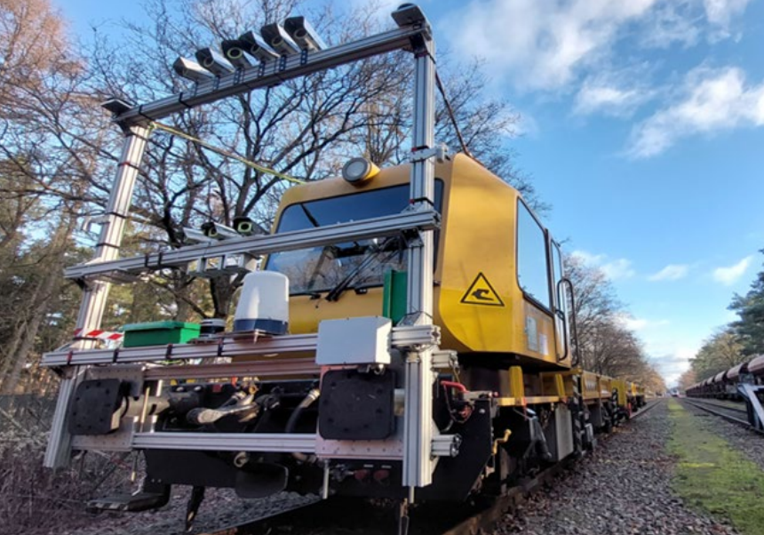
Motivation
Goal: identify and segment rail tracks
Input: images generated by different sensors mounted on locomotive

Slide 4
Dataset
OSDaR23 dataset (Digitale Schiene / Deutsche Bahn) → Training and evaluation
7.421 frames from 45 video sequences
27.386 labels
Low/high resolution RGB camera and infrared camera
RailSem19 dataset (Austrian Institute of Technology) → Training
8.500 images
58.483 labels
Only RGB images
Video stream (M2C / DB Cargo) → Evaluation
1:14h video
Different scenarios such as tunel, double/single track, side walls etc.

Slide 5
Solution approach
Non-AI-based segmentation with fast line detection (FLD)
Detect edges in image
Extract line segments
Grouping of line segments based on orientation and proximity
Deep-learning based approach based on YOLOv8
Train model with pre-labeled images
Classify each pixel in an image according to its category (rail tracks vs. background)
Convert pixels into polylines
Evaluation criterion
Dice score – best suited for unbalanced datasets, e.g., when the background is dominant

Slide 6
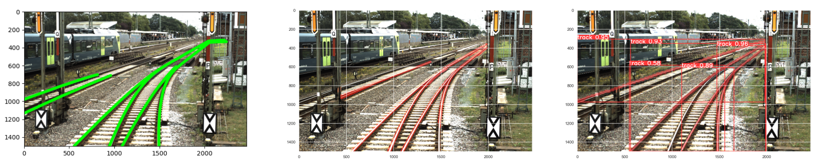
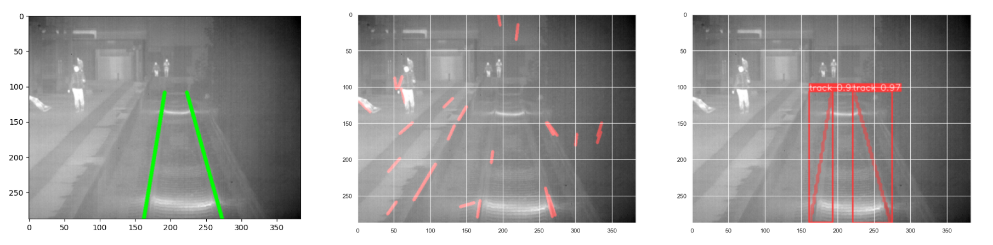
Results – Visual inspection
Ground truth
FLD
YOLO

Slide 7
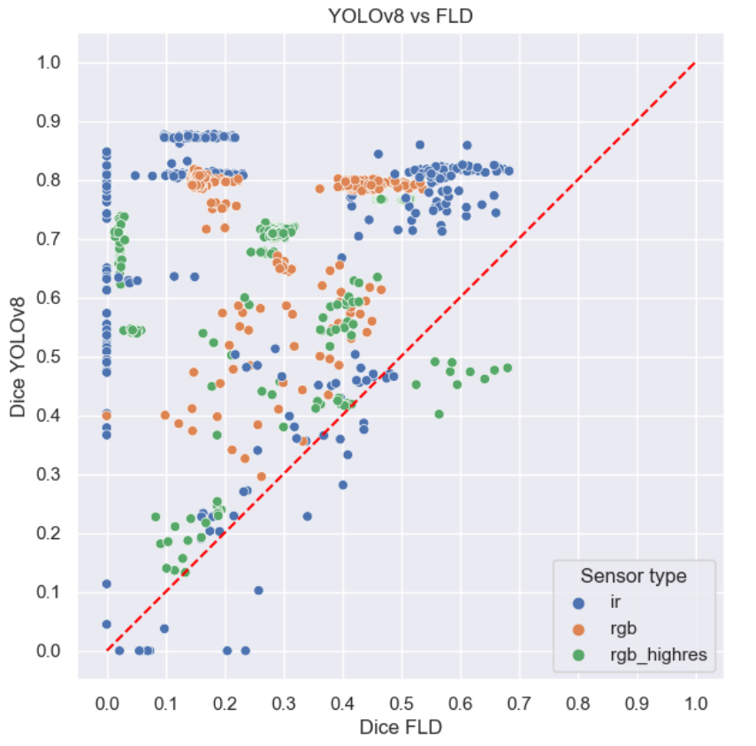
Results – FLD vs. YOLOv8 on OSDaR23
Each point denotes one image

Slide 8
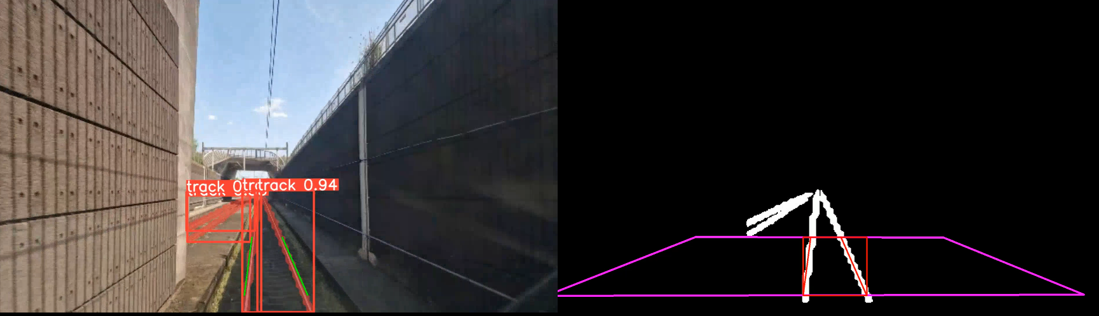
Results – Video stream: incorportating domain knowledge

Slide 9
Conclusion
First project to investigate different sensor types in rail track detection
Devised traditional base-line approach (FLD) and AI-based approach (YOLO)
YOLO outperforms FLD in almost all test images based on Dice-score
YOLO seems to provide very good results on infrared images
Best performace is achieved if AI-based track detection is enhanced by domain knowledge

Slide 10
Thanks!

Slide 11
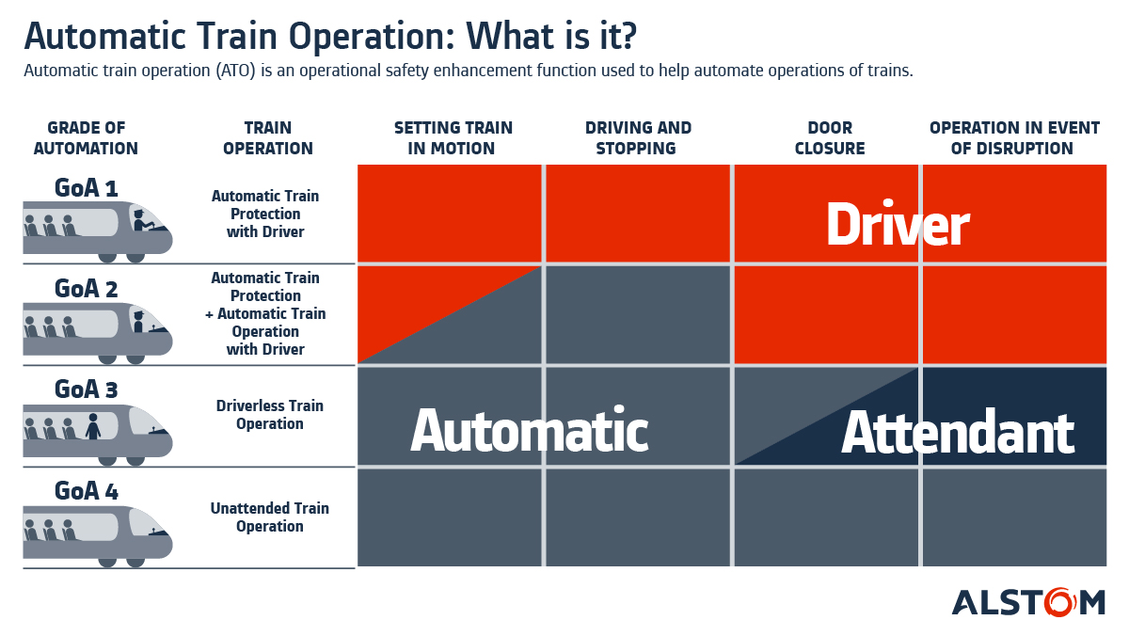
Automatic train operations

Slide 12
Challenges
Size of dataset becomes often a limiting factor (disk, RAM, CPU)
Refactoring existing approaches for lane detection proved difficult
Organization of experiments
A lot of custom code
Resource intensive training despite HPC
Working with HPC (scheduling, data transfer, versioning)
Model tuning can take up to one week

Slide 13
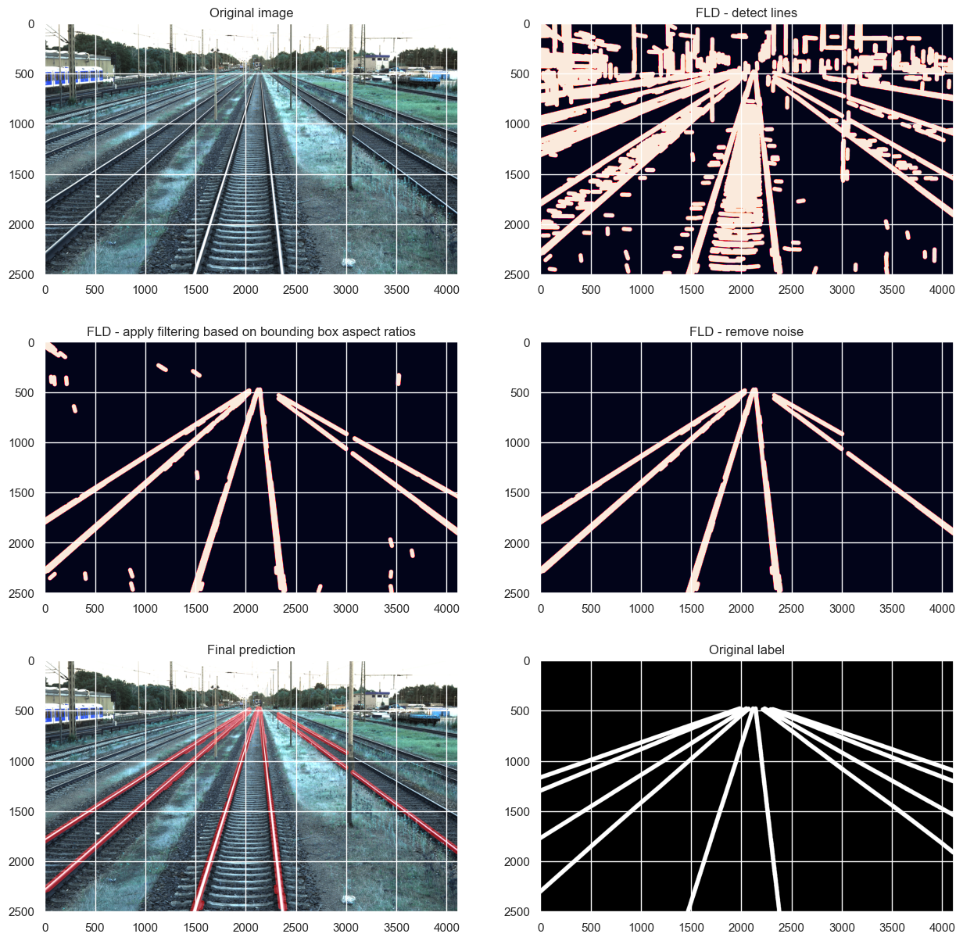
Non-AI-based segmentation with fast line detection (FLD)
Apply FLD
Filtering by removing „unusual“ lines
Removing noise based on clustering
Labels are given in the dataset

Slide 14
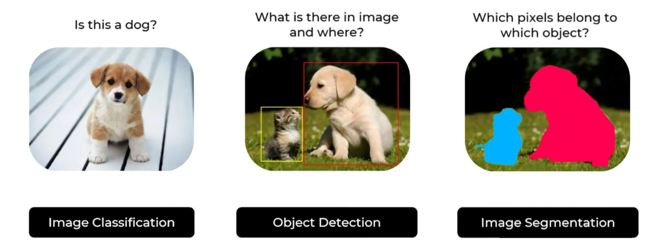
Deep-learning based approach based on YOLOv8
There are differenet applications in AI-based computer vision

Slide 15
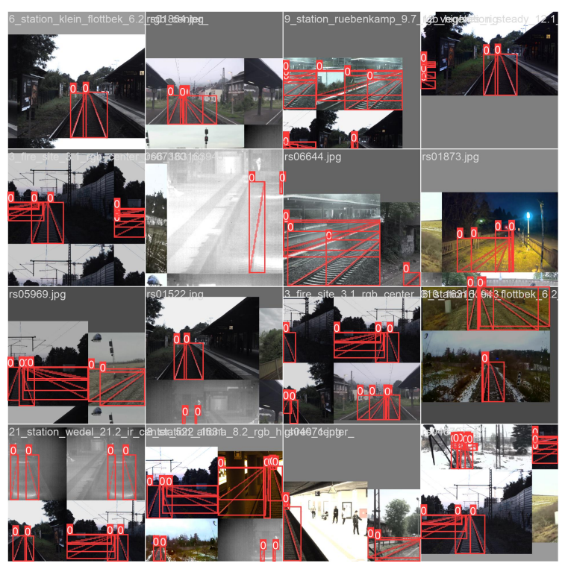
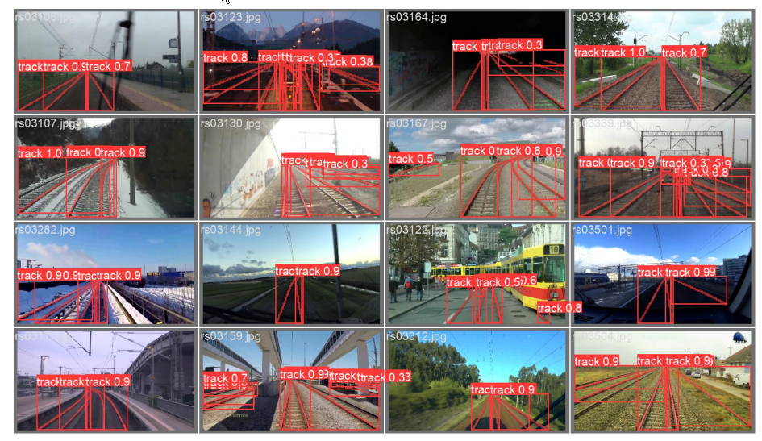
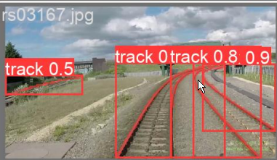
Deep-learning based approach based on YOLOv8
In each step of the training process, the model is provided with labeled images
The model is evaluated on images from the validation set

Slide 16
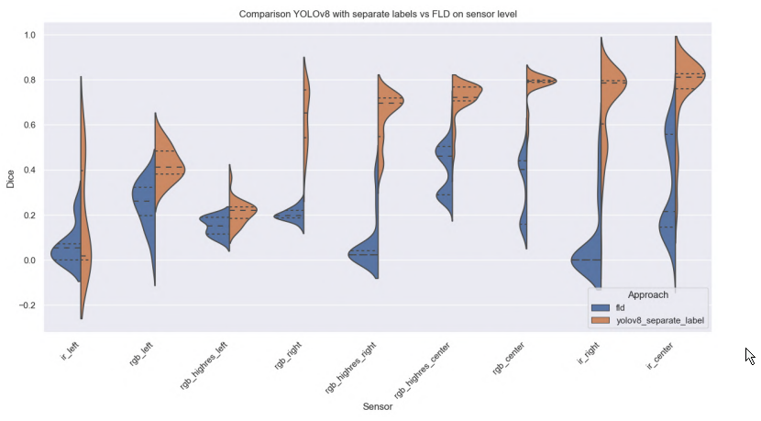
Results per sensor

Slide 17
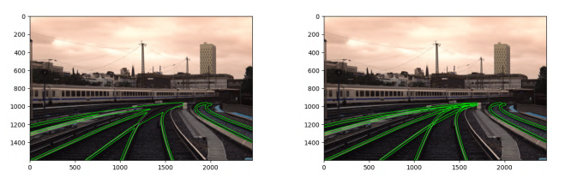
Labelling approaches

Slide 18
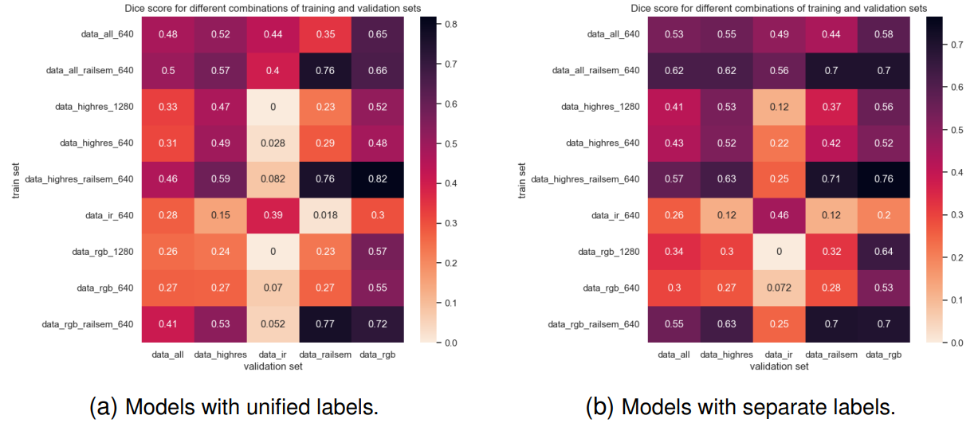
Tested YOLOv8 models

Slide 19
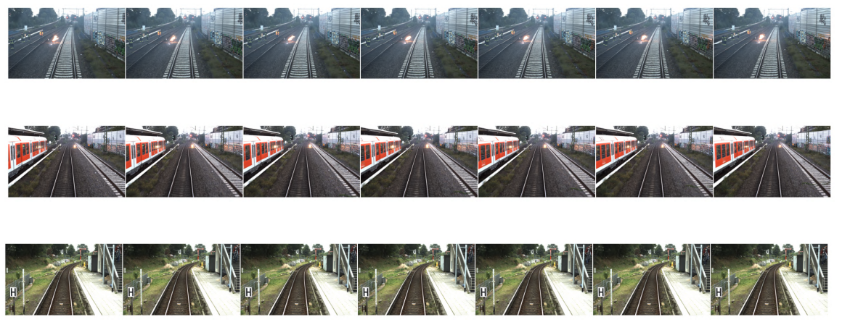
Frames of a video sequence

Slide 20

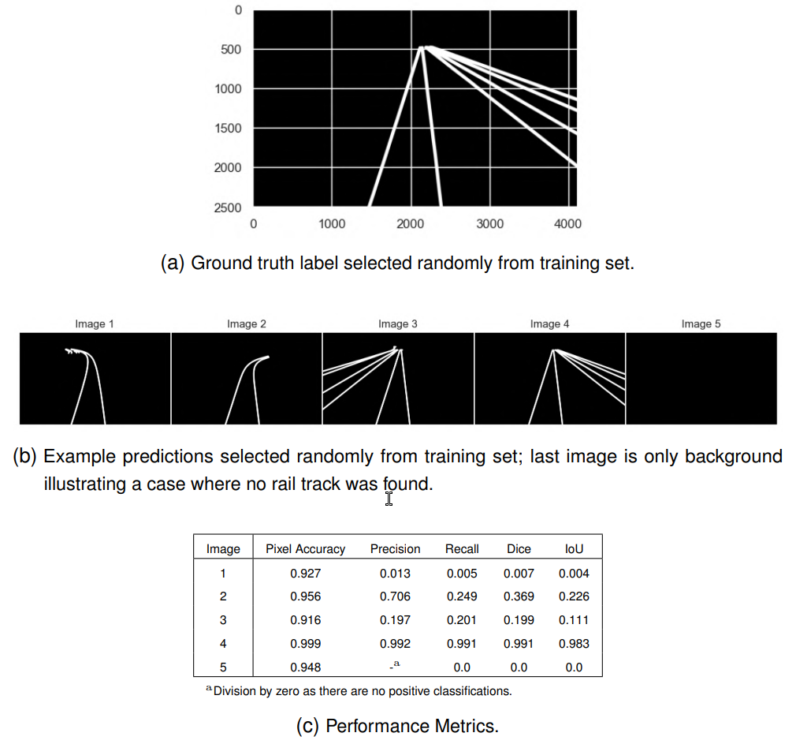
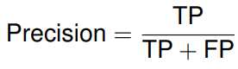
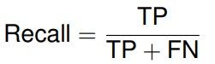
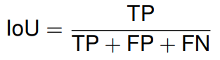
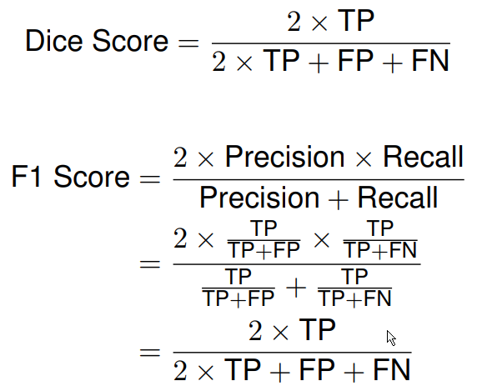
Performance metrics

